Slide 1
UCM102: Introduction to Information and Communication Technology
Lecturer : Dr. UWITONZE Alfred
Cell phone : 0788549588
E-mail : alfruwitonze@gmail.com

Slide 2
Course outline
Chapter 1: Introduction to Computers
Chapter 2: Operating Systems
Chapter 3: Binary and Decimal Number Systems
Chapter 4: Internet Applications
Chapter 5: Introduction to Computer Security
Chapter 6: Microsoft Office Word 2007
Chapter 7: Microsoft Office Excel 2007
Chapter 8: Microsoft Office PowerPoint 2007

Slide 3
ASSESSMENT
CONTINUOUS ASSESSMENT TESTS (CATs):
  CAT 1 (At least 3 Assignments): 30%
  CAT 2: 30%
FINAL ASSESSMENT TEST (FAT):
  40%

Slide 4
Aims of the module
The goal of this module is to educate students with information technology knowledge and skills that will enable them cope with an information-rich society and continue to learn throughout their lives.

Slide 5
Chapter 1: Introduction to Computers
What is a computer?
A computer is an electronic device which is capable of receiving the inputs (data from the user), storing it for a desired period of time, manipulating it according to the set of instructions (called program) and producing the output to the user in desired form.
It performs a variety of operations in accordance to the set of instructions.

Slide 6
Computer Hardware
The term computer hardware refers to the physical components of a computer – basically, the parts and pieces that can be touched or moved, whether inside or outside of the computer.
The following figure shows basic computer hardware components.

Slide 7

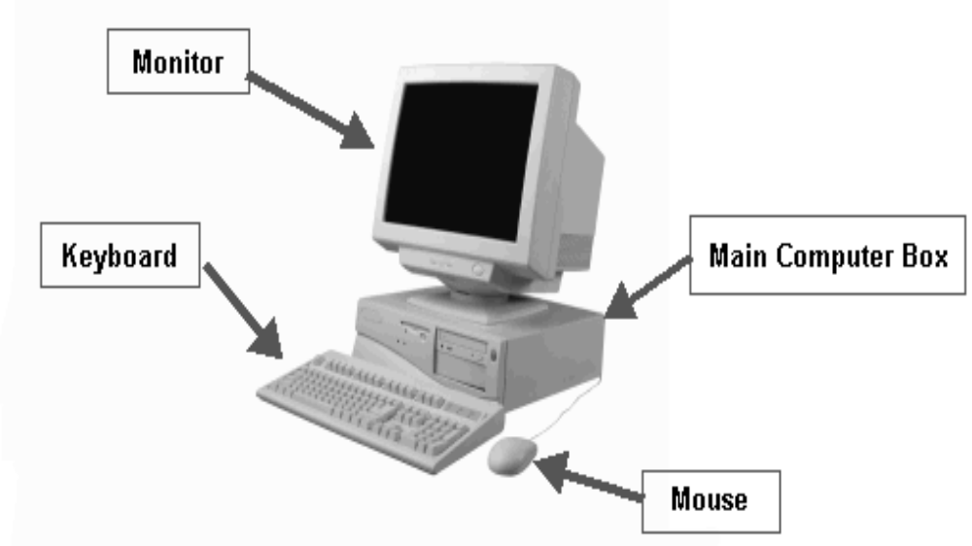
Computer Hardware

Slide 8
Computer System
A computer system is an interconnected computers that share a central storage system and various peripheral devices such as a printers, scanners, or routers.
Each computer connected to the system can operate independently, but has the ability to communicate with other external devices and computers.

Slide 9
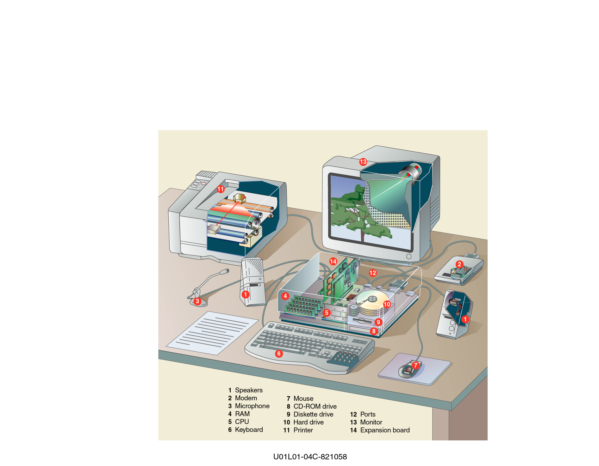
Computer Hardware

Slide 10
Computer System
In our case a computer system is an interconnection of central processing Unit and various peripheral devices such as monitor, keyboard, mouse, printer, and scanner.
A complete computer system includes four distinct parts:
  Hardware
  Software
  Data
  User

Slide 11
Software
Software is general term used to describe all the various programs and it consists of organized sets of instructions for operating the computer system.
Some programs exist for the computer's use, to help it manage its own tasks and devices; these operations may include identifying, accessing and processing information.

Slide 12
Software
Other programs exist for the user, and enable the computer to perform tasks for you, such as creating documents.

Slide 13
Data and User
Data is information that has been translated into a form that is more convenient to move or process while a user is human being who uses a computer.

Slide 14
Central Processing Unit (CPU)
Central Processing Unit (CPU) manages all devices and performs the actual processing of data.
The CPU is one of the most important element of the personal computer. On personal computers and small workstations, the CPU is contained on a single integrated circuit called the microprocessor. The computer will not run without a CPU.

Slide 15
Central Processing Unit (CPU)
The CPU contains two basic components:
The Arithmetic/Logic Unit (ALU) performs both arithmetic and logical operations.
Arithmetic operations are fundamental math operations like addition, subtraction, multiplication, and division.
Logical operations such as the AND, OR, and XOR are used to make comparisons and decisions, and these determine how a program is executed.

Slide 16
Central Processing Unit (CPU)
A Control Unit extracts instructions from memory and decodes and executes them, calling on the ALU when necessary.

Slide 17
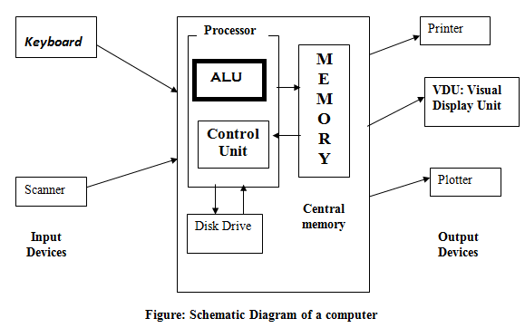
Central Processing Unit (CPU)

Slide 18
Memory
A memory is an electronic part of a computer in which data is stored for later use.
A computer memory refers to the physical devices used to store programs (sequences of instructions) or data on a temporary or permanent basis for use in a computer or other digital electronic device.
Memory is measured in bytes.

Slide 19
Types of memory
There are several different types of memory, but the two main types of memory are:
RAM (Random Access Memory): This is the main memory. RAM refers to read and write memory which means that you can both write data into RAM and read from RAM.
This is in contrast to ROM, which permits you only to read data.

Slide 20
Types of memory
ROM (Read Only Memory): Computers almost contain a small amount (a few thousands of bytes) of ROM that holds instructions for starting up/ booting the computer and perform diagnostics. Unlike RAM, ROM cannot be written to.
In fact, both types of memory (ROM and RAM) allow random access.
To be precise, therefore, RAM should be referred to as read/write RAM and ROM as read-only RAM.

Slide 21
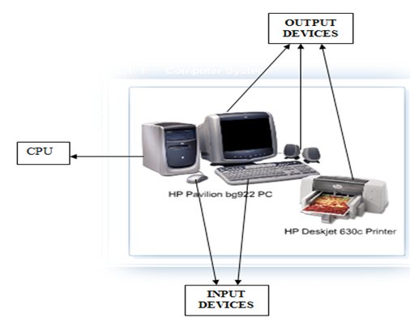
Input and Output (I/O) devices
The following figure shows you input and output of the computer.

Slide 22
What is input?
Input is any data or instructions provided to the computer by a person, the environment, or another computer.
People have a variety of options available to input data and instructions into a computer.
Input data is a collection of unprocessed text, words and symbols; numbers; pictures; audio signals from a microphone; signals from another computer; temperature, speed, pressures and video.

Slide 23
What is input?
Once data is in memory, the computer interprets and executes instructions to process the data into information.
Instructions are the steps that tell the computer how to perform a particular task. Instructions entered into the computer can be in the form of programs, or commands.

Slide 24
What is input?
A program is a series of instructions that tells the computer what to do and how to do it.
When a programmer writes a program, he or she inputs the program into the computer by using a keyboard, mouse or other input device.
Programs respond to commands that a user issues.

Slide 25
What is input?
A command is an instruction that causes a program to perform a specific action.
A user response is an instruction a user issues by replying to a question displayed by a program.

Slide 26
What are input devices?
Input devices accept data and instructions from the user or from another computer system.
An input device is any hardware component that allows users to enter data or instructions (programs, commands, and user response) into a computer.
Popular input devices include the keyboard, mouse, scanner, microphone and digital camera.

Slide 27
What are input devices?
Keyboard
A computer keyboard is an input device that contains alpha-numeric keys you press to enter data into the computer.
Desktop computer keyboards typically have from 101 to 105 keys.
Most keyboards use the QWERTY layout, named for the first six keys in the top row of letters.

Slide 28
What are input devices?
Keyboard
The QWERTY keyboard was designed 1800s for mechanical typewriters and was actually designed to slow typists down to avoid jamming keys.

Slide 29
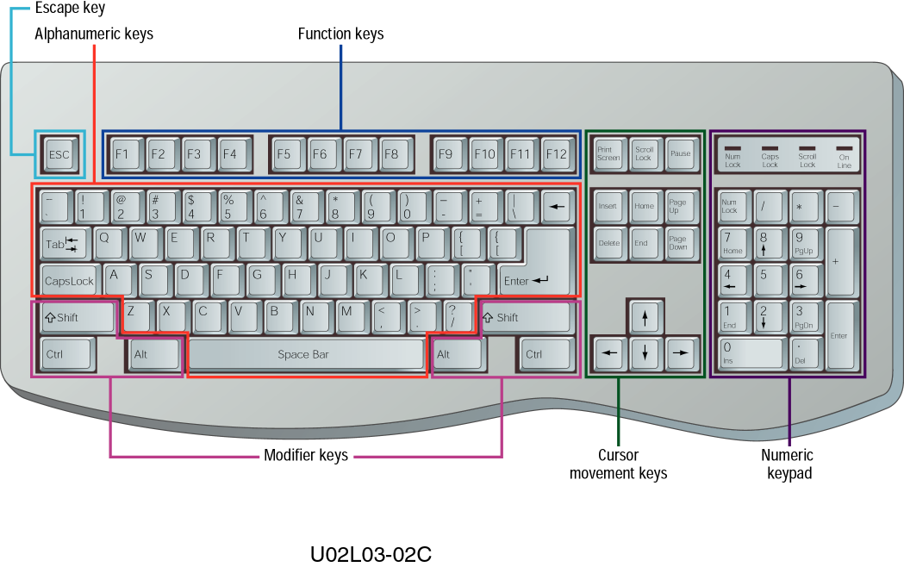
What are input devices?
Keyboard

Slide 30
What are input devices?
Mouse
A mouse is a pointing device that fits comfortably under the palm of your hand.
The mouse is the most widely used pointing device on desktop computers.
It is a small handheld device used to control the movement of a graphical pointer on the screen, often called a mouse pointer in this case.

Slide 31
What are input devices?
Mouse
The mouse can be used to issue commands, draw, and perform other types of input tasks.

Slide 32
Definition of Output Devices and Examples
Output devices return processed data back to the user or to another computer system.
An output device is any hardware component that displays, prints, or transmits the results of processing.
It conveys information to one or more people. Commonly used output devices are: display or monitor devices, printers, speakers, headsets and so on.

Slide 33
Definition of Output Devices and Examples
Monitor
The monitor looks like a television screen, except instead of watching television programs on it, the monitor allows for viewing of computer programs.
It is connected to the main computer box.
There are several types of monitors, but they all function in the same way.

Slide 34
Definition of Output Devices and Examples
Monitor
The power button is usually located on the front of the monitor, beneath the screen. Often, there will be a small light to indicate if the power is on. Here are two examples of different monitors:

Slide 35
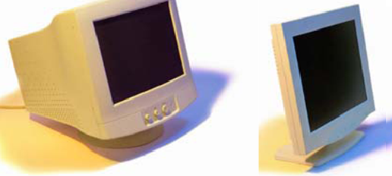
Definition of Output Devices and Examples
Monitor

Slide 36
Main Computer Box or central processing Unit (CPU)
The main computer box is the “brain” of the whole system.
The main computer box connects and allows all of the components to work together.
It also contains all of the information the computer needs to function, as well programs, which tell the computer what to do.

Slide 37
Main Computer Box or central processing Unit (CPU)
These programs can be very helpful to the user.
The programs can make it very easy to retrieve this stored information, make changes to the information, or add more information.
Programs can also allow for communication with relatives and friends, as well explore the World Wide Web.
All of this is just a click away.

Slide 38

Main Computer Box or central processing Unit (CPU)
All main computer boxes will have an on/off button. It will look similar to this:

Slide 39
Definitions
CD stands as Compact Disk.
CD-RAM stands as Compact Disk- Random Access Memory.
CD-R stands as Compact Disk Recordable.
CD-RW stands as Compact Disk- rewritable.
CD-ROM stands as Compact Disk- Read Only Memory.
Digital Versatile Disc (Digital Video Disc) in short is DVD

Slide 40
Definitions
A file: is an organized collection of information.
A folder: is an electronic container in which files can be stored. Folder may contain both files and other folders.
A virus: is a software program written with the intention of causing inconvenience and disruption or even serious damage to data on a computer.

Slide 41
Definitions
This can involve destroying anything from individual files to whole operating systems and networks.

Slide 42
Printer
Printers are still accessories, for now at least.
They perform a process, transferring information onto paper that is truly external to the other functions of the computer.
On a home computer, the printer is usually wired directly to the computer, but it is common to find printers in businesses where the printer is off away from the computer and performing printing operations for several computers, rather than just one.

Slide 43
END OF CHAPTER 1!!!

